Slide 1
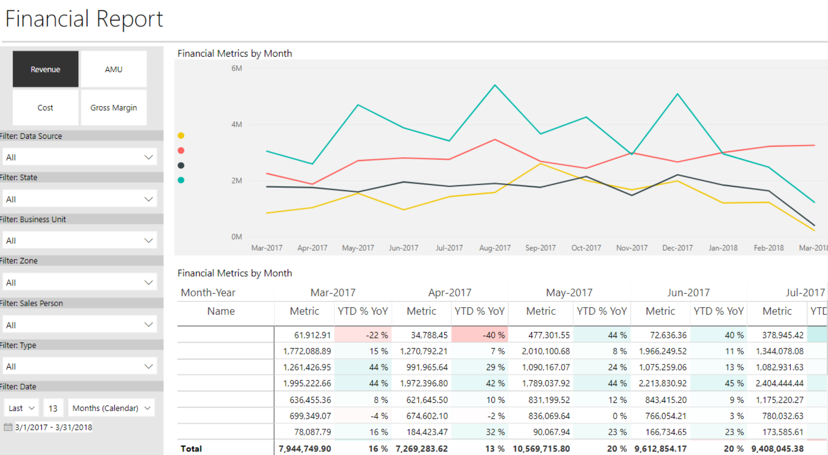
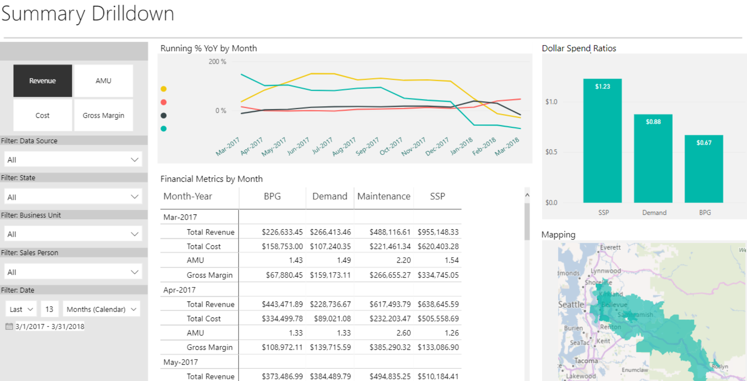
MacDonald Miller - Financial Metrics w/ Power BI

